Slide 1
3. An Introduction to Reactive Programming
PL3
Dr. Islam Gamal

Slide 2
Outline
Intro to reactive applications
The Observer pattern
Event-based languages
Reactive languages

Slide 3
INTRO TO REACTIVE APPLICATIONS

Slide 4







Software Taxonomy
A transformational system
Accepts input, performs computation on it, produces output, and terminates
Compilers, shell tools, scientific computations
A reactive system
Continuously interacts with the environment
Updates its state

Slide 5
Use of State
Transformational systems:
– Express transformations as incremental modifications of the internal data structures
State is not necessary to describe the system
Reactive systems:
Represent the current state of interaction
Reflect changes of the external world during interaction
State is essential to describe the system

Slide 6

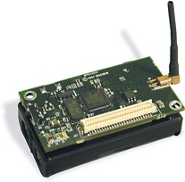




















Reactive Applications
Interactive Applications UI
Monitoring / Control Systems

Slide 7



Reactive Applications
Many other examples
Web applications
Mobile apps
Distributed computations
Cloud
– …
Typical operations
Detect events/notifications and react
Combine reactions
Propagate updates/changes

Slide 8

Reactive Applications Why should we care?
Event handling:
30% of code in desktop applications
50% of bugs reported during production cycle

Slide 9
Reactive Programming
Now…
Reactive applications are extremely common
Can we design new language features to specifically address this issue ?
Think about the problems solved by exceptions, visibility modifiers, inheritance, …

Slide 10
REACTIVE PROGRAMMING

Slide 11
Reactive Programming
Definition… ?
“Programming language abstractions (techniques and patterns)
to develop reactive applications”
For example, abstractions to:
Represent event streams
Automatically propagate changes in the state Combine events
…

Slide 12




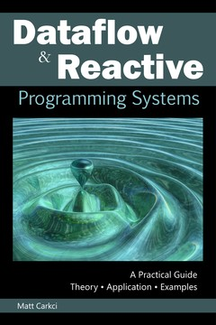

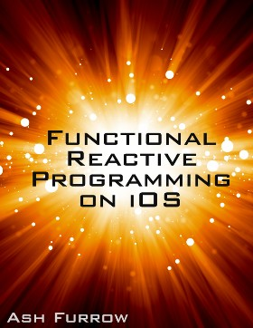
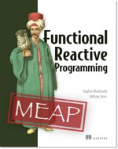
Reactive Programming
Haskell: Fran, Yampa
FrTime, Flapjax, REScala, Scala.react, …
Angular.js, Bacon.js, Reactive.js, …
Microsoft Reactive Extensions (Rx)
Books 2014-16

Slide 13


Reactive Programming

Slide 14

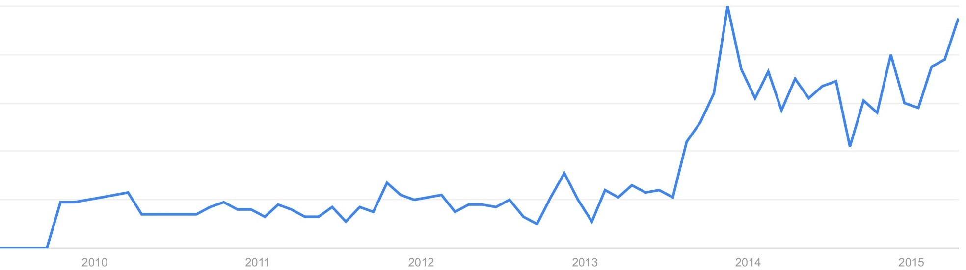
Reactive Programming

Slide 15
THE OBSERVER PATTERN

Slide 16
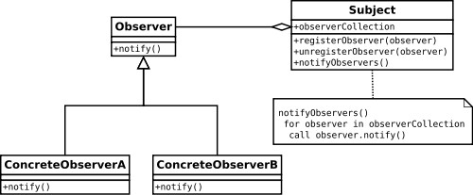
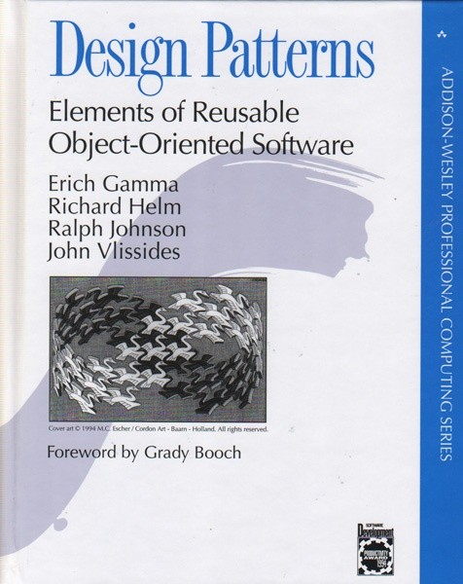
The (good? old) Observer Pattern

Slide 17
























The (good? old) Observer Pattern
boolean highTemp;
State
boolean smoke;
void Init() {
tempSensor.register(this); smokeSensor.register(this);
Registration
}
void notifyTempReading(TempEvent e ) {
highTemp = e.getValue() > 45; if (highTemp && smoke) {
alert.start();
}
}
Callback functions
Control statements
void notifySmokeReading(SmokeEvent e) { smoke = e.getIntensity() > 0.5; if (highTemp && smoke) {
alert.start();
}
}
Callback functions
Control statements

Slide 18

The Observer Pattern
What about Java Swing ?
– javax.swing
BEEEEP!

Slide 19
public class Beeper extends JPanel implements ActionListener { JButton button;
public Beeper() {
super(new BorderLayout()); button = new JButton("Click Me");
button.setPreferredSize(new Dimension(200, 80));
BEEEEP!
add(button, BorderLayout.CENTER);
button.addActionListener(this);
}
public void actionPerformed(ActionEvent e) { Toolkit.getDefaultToolkit().beep();
}
private static void createAndShowGUI() { // Create the GUI and show it.
JFrame frame = new JFrame("Beeper"); //Create and set up the window. frame.setDefaultCloseOperation(JFrame.EXIT_ON_CLOSE);
JComponent newContentPane = new Beeper(); //Create and set up the content pane. newContentPane.setOpaque(true);
frame.setContentPane(newContentPane); frame.pack(); //Display the window. frame.setVisible(true);
}
public static void main(String[] args) {
javax.swing.SwingUtilities.invokeLater( new Runnable() { public void run() {createAndShowGUI();}});
}
}

Slide 20
EVENT-BASED LANGUAGES

Slide 21
Example in C#
public class Drawing { Collection<Figure> figures; public event NoArgs Changed();
public virtual void Add(Figure figure) { figures.Add(figure);
figure.Changed += OnChanged; OnChanged();
}
public virtual void Remove(Figure figure) { figures.Remove(figure);
figure.Changed -= OnChanged; OnChanged();
}
protected virtual void OnChanged() {
if (Changed != null) { Changed(); }
}
...
}

Slide 22
Event-based Languages
Language-level support for events
Events as object attributes
Describe changes of the object's state
Part of the interface
Event-based languages are better!
More concise, clear programming intention, …
C#, Ptolemy, EScala, EventJava, …

Slide 23
EVENTS IN SCALA

Slide 24
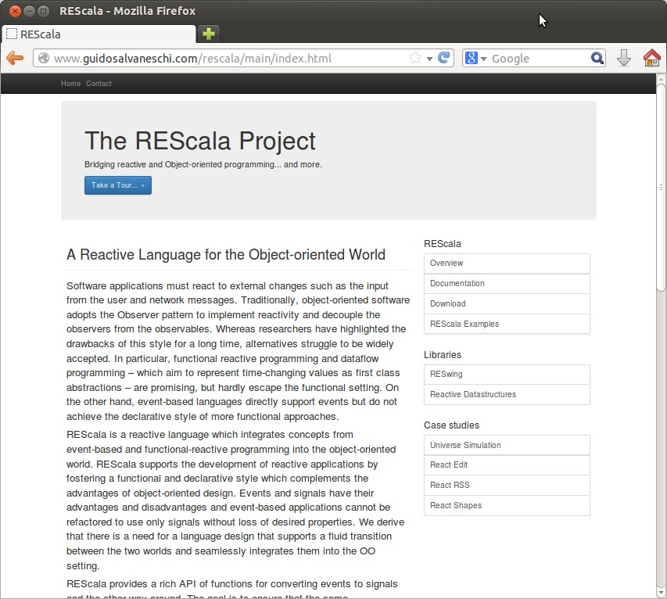
REScala
www.rescala-lang.com
An advanced event-based system
Abstractions for time-changing values
Bridging between them
Philosophy: foster a more declarative and functional style without sacrificing the power of OO design
Pure Scala

Slide 25
Adding Events to Scala
C# events are recognized by the compiler
Scala does not support events by itself, but…
Can we introduce events using the powerful Scala support for DSLs?
Can we do even better than C# ?
E.g., event composition ?

Slide 26
REScala events: Summary
Different types of events: Imperative, declarative, …
Events carry a value
Bound to the event when the event is fired
Received by all the handlers
Events are parametric types.
Event[T], Evt[T]
All events are subtype of Event[T]

Slide 27
Imperative Events
Valid event declarations
val e1 = Evt[Unit]() val e2 = Evt[Int]() val e3 = Evt[String]()
val e4 = Evt[Boolean]()
val e5: Event[Int] = Evt[Int]() class Foo
val e6 = Evt[Foo]()

Slide 28
Imperative Events
Multiple values for the same event are expressed using tuples
val e1 = Evt[(Int,Int)]()
val e2 = Evt[(String,String)]()
val e3 = Evt[(String,Int)]()
val e4 = Evt[(Boolean,String,Int)]() val e5: Evt[(Int,Int)] = Evt[(Int,Int)]()

Slide 29
Handlers
Handlers are executed when the event is fired
The += operator registers the handler.
The handler is a first class function
The attached value is the function parameter.
var state = 0
val e = Evt[Int]() e += { println(_) }
e += (x => println(x))
e += ((x: Int) => println(x))
e += (x => { // Multiple statements in the handler state = x
println(x)
})

Slide 30
Handlers
The signature of the handler must conform the event
E.g., Event[(Int,Int)] requires (Int,Int) =>Unit
The handler:
receives the attached value
performs side effects.
val e = Evt[(Int,String)]() e += (x => {
println(x._1) println(x._2)
})
e += (x: (Int,String) => { println(x)
})

Slide 31
Handlers
Events without arguments still need a Unit argument in the handler.
val e = Evt[Unit]()
e += { x => println(“Fired!”) }
e += { (x: Unit) => println(“Fired!”) }

Slide 32
Methods as Handlers
Methods can be used as handlers.
Partially applied functions syntax
Types must be correct
def m1(x: Int) = { val y = x + 1 println(y)
}
val e = Evt[Int] e += m1 _ e(10)

Slide 33
Firing Events
Method call syntax
The value is bound to the event occurrence
val e1 = Evt[Int]()
val e2 = Evt[Boolean]() val e3 = Evt[(Int,String)]()
e1(10)
e2(false) e3((10,"Hallo"))

Slide 34
Firing Events
Registered handlers are executed every time the event is fired.
– The actual parameter is provided to the handler
val e = Evt[Int]()
e += { x => println(x) } e(10)
e(11)
-- output ---- 10
11

Slide 35
Firing Events
All registered handlers are executed
– The execution order is non deterministic
val e = Evt[Int]()
e += { x => println(x) }
e += { x => println("n: " + x)} e(10)
e(11)
-- output ---- 10
n: 10
11
n: 11

Slide 36
Firing Events
The .remove operator unregisters a handler via its handle
The += operator also returns the handle that will be used for unregistration
val e = Evt[Int]()
val handler1 = { x: Int => println(x) }
val handler2 = { x: Int => println("n: " + x) }
val h1 = e += handler1 val h2 = e += handler2 e(10)
h1.remove e(10)
h2.remove e(10)
-- output ---- 10
n: 10
n: 10

Slide 37
Imperative Events
Events can be referred to generically
val e1: Event[Int] = Evt[Int]()

Slide 38
DECLARATIVE EVENTS

Slide 39



The Problem
Imperative events are fired by the programmer
Conceptually, certain events depend on other events
?
Examples:
mouseClickE -> museClickOnShape
mouseClose, keyboardClose -> closeWindow
Can we solve this problem enhancing the language?

Slide 40
Declarative Events
Declarative events are defined by a combination of other events.
Some valid declarations:
val e1 = Evt[Int]() val e2 = Evt[Int]()
val e3 = e1 || e2
val e4 = e1 && ((x: Int)=> x>10)
val e5 = e1 map ((x: Int)=> x.toString)

Slide 41
OR events
The event e1 || e2 is fired upon the occurrence of one among e1 or e2.
– The events in the event expression have the same parameter type
val e1 = Evt[Int]() val e2 = Evt[Int]()
val e1_OR_e2 = e1 || e2 e1_OR_e2 += ((x: Int) => println(x)) e1(10)
e2(10)
-- output ---- 10
10

Slide 42
Predicate Events
The event e && p is fired if e occurs and the predicate p is satisfied.
The predicate is a function that accepts the event parameter as a formal and returns Boolean.
&& filters events using a parameter and a predicate.
val e = Evt[Int]()
val e_AND: Event[Int] = e && ((x: Int) => x>10) e_AND += ((x: Int) => println(x))
e(5)
e(15)
-- output ---- 15

Slide 43
Map Events
The event e map f is obtained by applying f to the value carried by e.
The map function takes the event parameter as a formal.
The return type of map is the type parameter of the resulting event.
val e = Evt[Int]()
val e_MAP: Event[String] = e map ((x: Int) => x.toString) e_MAP += ((x: String) => println("Here: " + x))
e(5)
e(15)
-- output ---- Here: 5
Here: 15

Slide 44
EXAMPLES OF RESCALA EVENTS

Slide 45
Example: Figures
abstract class Figure {
val moved[Unit] = afterExecMoveBy
val resized[Unit]
val changed[Unit] = resized || moved || afterExecSetColor
val invalidated[Rectangle] = changed.map( _ => getBounds() )
...
val afterExecMoveBy = new Evt[Unit]
val afterExecSetColor = new Evt[Unit]
…
def moveBy(dx: Int, dy: Int) { position.move(dx, dy); afterExecMoveBy() }
def resize(s: Size) { size = s }
def setColor(col: Color) { color = col; afterExecSetColor() }
def getBounds(): Rectangle
...
}

Slide 46
Example: Figures
class Connector(val start: Figure, val end: Figure) { val h1 = start.changed += updateStart _
val h2 = end.changed += updateEnd _
...
def updateStart() { ... }
def updateEnd() { ... }
...
def dispose { h1.remove h2.remove
}
}

Slide 47
Example: Figures
Inherited events
May be overridden
Are late bound
abstract class Figure {
val moved[Unit] = afterExecMoveBy
val resized[Unit]
…
}
class RectangleFigure extends Figure {
val resized = afterExecResize || afterExecSetBounds
override val moved = super.moved || afterExecSetBounds
...
val afterExecResize = new Evt[Unit]
val afterExecSetBounds = new Evt[Unit]
…
def resize(s: Size) { ... ; afterExecResize() }
def setBounds(x1: Int, y1: Int, x2: Int, y2: Int) { ... ; afterExecSetBounds }
...
}

Slide 48
Example: Temperature Sensor
class TemperatureSensor {
val tempChanged[Int] = new Evt[Int]
...
def run {
var currentTemp = measureTemp()
while(!stop) {
val newTemp = measureTemp() if (newTemp != currentTemp) { tempChanged(newTemp)
currentTemp = newTemp
}
sleep(100)
}
}
}

Slide 49
REACTIVE LANGUAGES

Slide 50
Events and Functional Dependencies
Events are often used for
val update = Evt[Unit]()
functional dependencies
boolean highTemp := (temp.value > 45);
var a = 3
var b = 7
var c = a + b // Functional dependency
update += ( _ =>{ c = a + b
})
var a = 3 var b = 7 val c = a + b
a = 4 update() b = 8 update()
a = 4
b = 8

Slide 51
Constraints
What about expressing functional dependencies as constraints ?
val a = 3
val b = 7
val c = a + b // Statement println(c)
> 10
a= 4 println(c)
> 10
val a = 3
val b = 7
val c := a + b // Constraint println(c)
> 10
a= 4 println(c)
> 11

Slide 52
EMBEDDING REACTIVE PROGRAMMING IN SCALA

Slide 53
Reactive Values
Vars: primitive reactive values
Updated “manually”
Signals: reactive expressions
The constraints “automatically” enforced
val a = Var(3)
val b = Var(7)
val c = Signal{ a() + b() } println(c.now)
> 10
a()= 4
println(c.now)
> 11

Slide 54
Reference Model
Change propagation model
Dependency graph
Push-driven evaluation
…
i
f g h d e
val a = Var(3)
val b = Var(7)
val c = Signal{ a() + b() }
val d = Signal { 2 * c() }
…
d
c
a
b

Slide 55
SIGNALS AND VARS

Slide 56
Vars
Vars wrap normal Scala values
Var[T] is a parametric type.
The parameter T is the type the var wraps around
Vars are assigned by the “()=“ operator
val a = Var(0)
val b = Var("Hello World")
val c = Var(false)
val d: Var[Int] = Var(30)
val e: Var[String] = Var("REScala")
val f: Var[Boolean] = Var(false)
a()= 3
b()=“New World” c()=true

Slide 57
Signals
Syntax: Signal{sigexpr}
Sigexpr should be side-effect free
Signals are parametric types.
A signal Signal[T] carries a value of type T

Slide 58
Signals: Collecting Dependencies
A Var or a Signal called with () in a signal expression is added to the dependencies of the defined signal
// Multiple vars
// in a signal expression
val a = Var(0)
val b = Var(0)
val s = Signal{ a() + b() }
c
a
b

Slide 59
Signals: Examples
val a = Var(0) val b = Var(0) val c = Var(0)
val r: Signal[Int] = Signal{ a() + 1 }
val s = Signal{ a() + b() }
val t = Signal{ s() * c() + 10 }
val u = Signal{ s() * t() }
// Explicit type in var decl
// Multiple vars is a signal expression
// Mix signals and vars in signal expressions
// A signal that depends on other signals

Slide 60
Signals: Examples
val a = Var(0) val b = Var(2) val c = Var(true)
val s = Signal{ if (c()) a() else b() }
def factorial(n: Int) = ...
val a = Var(0)
val s: Signal[Int] = Signal{ // A signal expression can be any code block
val tmp = a() * 2
val k = factorial(tmp)
k + 2 // Returns an Int
}

Slide 61
Signals
Accessing reactive values: now
– Often used to return to a traditional computation
val a = Var(0) val b = Var(2) val c = Var(true)
val s: Signal[Int] = Signal{ a() + b() }
val t: Signal[Boolean] = Signal{ !c() }
val x: Int = a.now
val y: Int = s.now
val z: Boolean = t.now println(z)

Slide 62
EXAMPLES OF SIGNALS

Slide 63
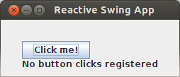
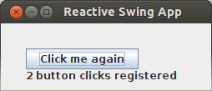
Example

Slide 64
Example: Observer
/* Create the graphics */ title = "Reactive Swing App" val button = new Button { text = "Click me!"
}
val label = new Label {
text = "No button clicks registered"
}
contents = new BoxPanel(Orientation.Vertical) { contents += button
contents += label
}
/* The logic */ listenTo(button) var nClicks = 0 reactions += {
case ButtonClicked(b) => nClicks += 1
label.text = "Number of button clicks: " + nClicks
if (nClicks > 0)
button.text = "Click me again"
}

Slide 65
Example: Signals
title = "Reactive Swing App"
val label = new ReactiveLabel
val button = new ReactiveButton
val nClicks = button.clicked.fold(0) {(x, _) => x + 1}
label.text = Signal { ( if (nClicks() == 0) "No" else nClicks() ) + " button clicks registered" } button.text = Signal { "Click me" + (if (nClicks() == 0) "!" else " again " )}
contents = new BoxPanel(Orientation.Vertical) { contents += button
contents += label
}

Slide 66
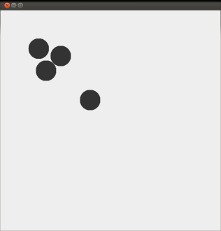
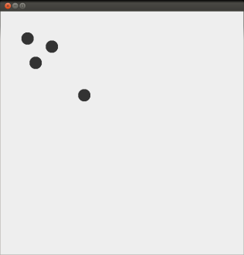
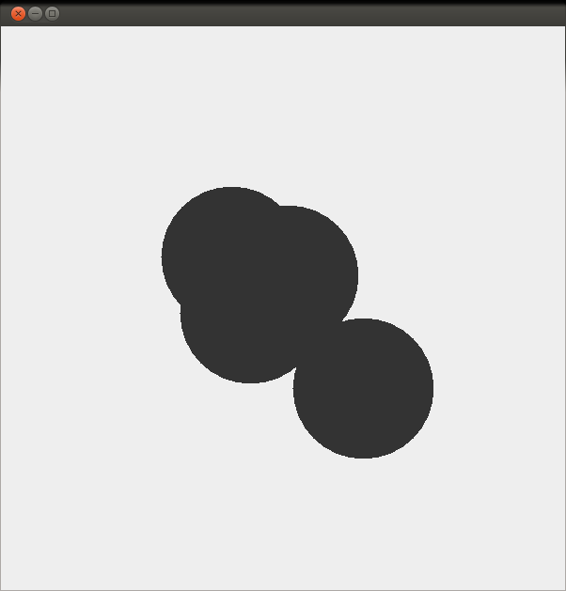
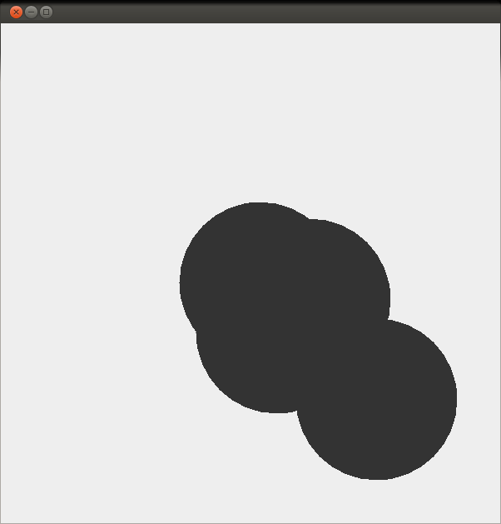
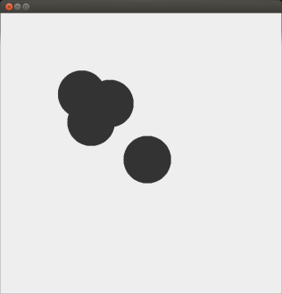
Example: Smashing Particles
class Oval(center: Signal[Point], radius: Signal[Int]) { … }
val base = Var(0) // Increases indefinitely
val linearTime = base()
val cyclicTime = Signal{linearTime() % 200}
val point1 = Signal{ new Point(20+ cyclicTime (), 20+ cyclicTime ()) }
new Oval(point1, cyclicTime )
… // 4 times
66

Slide 67
BASIC CONVERSION FUNCTIONS

Slide 68

REScala design principles
Signals (and events) are objects fields
– Inheritance, late binding, visibility modifiers, …
Conversion functions bridge signals and events
SIGNALS
EVENTS

Slide 69
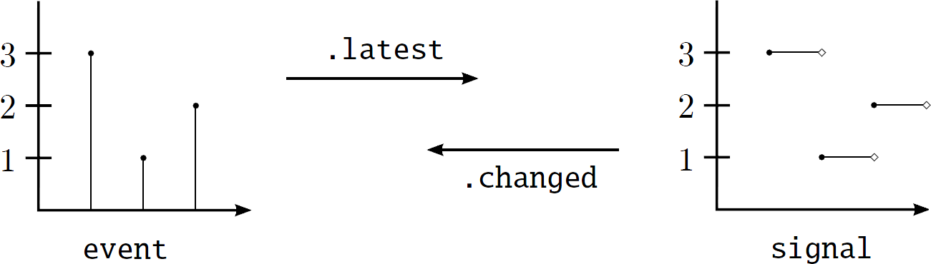
Basic Conversion Functions
Changed :: Signal[T] -> Event[T]
Latest :: Event[T] -> Signal[T]

Slide 70
Example: Changed
val SPEED = 10
val time = Var(0)
val space = Signal{ SPEED * time() }
while (true) {
Thread sleep 20 time() = time.now + 1
}
space.changed += ((x: Int) => println(x))
-- output -- 10
20
30
40
...

Slide 71
Example: Latest
val senseTmp = Evt[Int]() // Fahrenheit
val threshold = 40
val fahrenheitTmp = senseTmp.latest(0)
val celsiusTmp = Signal{ (fahrenheitTmp() – 32) / 1.8 }
val alert = Signal{ if (celsiusTmp() > threshold ) “Warning ” else “OK” }

Slide 72
Quiz 1
val v1 = Var(4)
val v2 = Var(2)
val s1 = Signal{ v1() + v2() }
val s2 = Signal{ s1() / 3 }
assert(s2.now == 2) v1()=1
assert(s2.now == 1)

Slide 73
Quiz 2
var test = 0
val v1 = Var(4)
val v2 = Var(2)
val s1 = Signal{ v1() + v2() } s1.changed += ((x: Int)=>{test+=1})
assert(test == 0) v1()=1
assert(test == 1)

Slide 74
Quiz 3
val e = Evt[Int]() val v1 = Var(4) val v2 = Var(2)
val s1 = e.latest(0)
val s2 = Signal{ v1() + v2() + s1() }
assert(s2.now == 6) e(2)
assert(s2.now == 8) e(1)
assert(s2.now == 7)

Slide 75
TRUBLESHOOTING

Slide 76
Common pitfalls
Establishing dependencies
– () creates a dependency.
Use only in signal expressions
c
a b
– now returns the current value
val a = Var(2)
val b = Var(3)
val c = Signal{ a.now + b() }
Signals are not assignable.
Depend on other signals and vars
Are automatically updated

Slide 77




Common pitfalls
Avoid side effects in signal expressions
var c = 0
val s = Signal{
val sum = a() + b(); c = sum * 2
}
...
foo(c)
val c = Signal{
val sum = a() + b(); sum * 2
}
...
foo(c.now)
Avoid cyclic dependencies
val a = Var(0)
val s = Signal{ a() + t() }
val t = Signal{ a() + s() + 1 }

Slide 78
Reactive Abstractions and Mutability
Signals and vars hold references to objects, not the objects themselves.
class Foo(init: Int){
var x = init
}
val foo = new Foo(1)
class Foo(init: Int){
var x = init
}
val foo = new Foo(1)
class Foo(x: Int) //Immutable
val foo = new Foo(1)
val varFoo = Var(foo)
val s = Signal{ varFoo().x + 10
}
assert(s.now == 11)
varFoo()= new Foo(2) assert(s.now == 12)
val varFoo = Var(foo) val s = Signal{ varFoo().x + 10
}
assert(s. now== 11)
foo.x = 2
assert(s.now == 11)
val varFoo = Var(foo) val s = Signal{ varFoo().x + 10
}
assert(s.now == 11)
foo.x = 2 varFoo()=foo assert(s.now == 11)

Slide 79
QUESTIONS?

